Slide 1











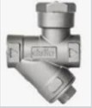


Azure Smart Device
(Sensor)
Sensor Technology
Edge Computing
Azure Cloud Solution
Third Party
Visualization
Equipment
Raw Data
Analyzed Data
Azure Data Factory
Azure Database
(CC Datahub/
Smart Asset DB)
Event Hub
Power BI
IOT Edge Device
Azure Databricks
Azure Data Lake
Delta Lake

